Slide 1
DSO 599 Capstone Project
Linglan Mei 3640040061

Slide 2
Most popular shopping path
It’s said that “The path of your shopper can tell you what areas you need to grow or reduce, and provide insight into the motivations and interests of your customers.”
Based on the dataset, unique arrays of aisle_ids were counted to find the top 10 shoppings paths
Firstly, I joined order_product table and product table to find distinct order_id and aisle_id pairs. Secondly, I grouped the data by order_id’s and concatenate aisle_id’s to get unique paths of each order_id. Finally, I grouped the data by paths and counted each path to determine the top shopping paths

Slide 3
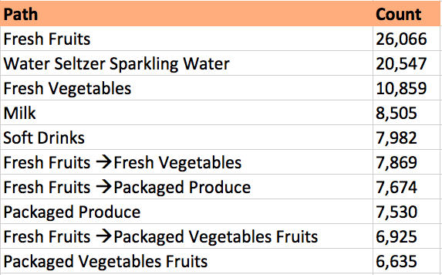
Most popular shopping path
The following is the list of the top 10 shopping paths
According to the result, it’s obvious that the most frequent aisles are the ones that’re necessary for daily life and is easy to deteriorate, such as fresh fruits and fresh vegetables

Slide 4
Sales Promotion
Predictive analysis based on data of sale is important for retail companies on the business strategy. Because of a story about beer and diapers, we get to know that the way of placing goods can even have a giant effect on the store’s profitability
Based on the dataset:
Firstly, I joined order_product table and orders table to find unique order_id and corresponding product_id pairs. Secondly, I grouped the data by unique product pairs and found aggregate counts of unique pairs and sorted them in descending order to find the top ones

Slide 5
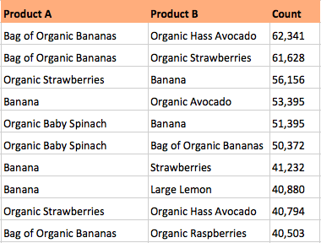
Sales Promotion
The top 10 pairs of goods that are usually bought together are listed in the chart
A interesting finding is that banana (and organic banana) appears 9 times. Also, the pairs are always the combination of banana and other fruit or vegetables
Since banana is perishable and so does other fruit or vegetables, the result is understandable and I recommend the store to put banana and other organic fruit (like strawberry) or vegetables (like avocado) together and it could be better id they’re near the door or cashier

Slide 6
Hive
All the code in Hive is shown in the sql file
Thank you professor for teaching us this useful tool and support us the whole 8 weeks!=)

